Slide 1


GRADE 12 STUDENT TEXT BOOK
New curriculum
DILACHIN GENERAL SECONDARY SCHOOL NATURAL SCIENCE
PHYSICS

Slide 2
GRADE 12 STUDENT TEXT BOOK
New curriculum
DILACHIN GENERAL SECONDARY SCHOOL NATURAL SCIENCE
BIOLOGY

Slide 3
GRADE 12 STUDENT TEXT BOOK
New curriculum
DILACHIN GENERAL SECONDARY SCHOOL NATURAL SCIENCE
CHEMISTRY

Slide 4
GRADE 12 STUDENT TEXT BOOK
New curriculum
DILACHIN GENERAL SECONDARY SCHOOL NATURAL SCIENCE
TECHNICAL DRAWING

Slide 5
GRADE 12 STUDENT TEXT BOOK
New curriculum
DILACHIN GENERAL SECONDARY SCHOOL NATURAL SCIENCE
PHYSICS

Slide 6
GRADE 12 STUDENT TEXT BOOK
New curriculum
DILACHIN GENERAL SECONDARY SCHOOL SOCIAL SCIENCE
HISTORY

Slide 7
GRADE 12 STUDENT TEXT BOOK
New curriculum
DILACHIN GENERAL SECONDARY SCHOOL SOCIAL SCIENCE
GEOGRAPHY

Slide 8
GRADE 12 STUDENT TEXT BOOK
New curriculum
DILACHIN GENERAL SECONDARY SCHOOL SOCIAL SCIENCE
ECONOMICS

Slide 9
GRADE 12 STUDENT TEXT BOOK
New curriculum
DILACHIN GENERAL SECONDARY SCHOOL SOCIAL SCIENCE
GENERAL BUSINESS

Slide 10
GRADE 12 STUDENT TEXT BOOK
New curriculum
DILACHIN GENERAL SECONDARY SCHOOL COMMON COURSE
ENGLISH

Slide 11
GRADE 12 STUDENT TEXT BOOK
New curriculum
DILACHIN GENERAL SECONDARY SCHOOL COMMON COURSE
PHYSICAL EDUCATION

Slide 12
GRADE 12 STUDENT TEXT BOOK
New curriculum
DILACHIN GENERAL SECONDARY SCHOOL SOCIAL SCIENCE
MATHEMATICS

Slide 13
GRADE 12 STUDENT TEXT BOOK
New curriculum
DILACHIN GENERAL SECONDARY SCHOOL SOCIAL SCIENCE
MATHEMATICS

Slide 14
GRADE 12 STUDENT TEXT BOOK
New curriculum
DILACHIN GENERAL SECONDARY SCHOOL COMMON COURSE
INFORMATION
TECHNOLOGY

Slide 15
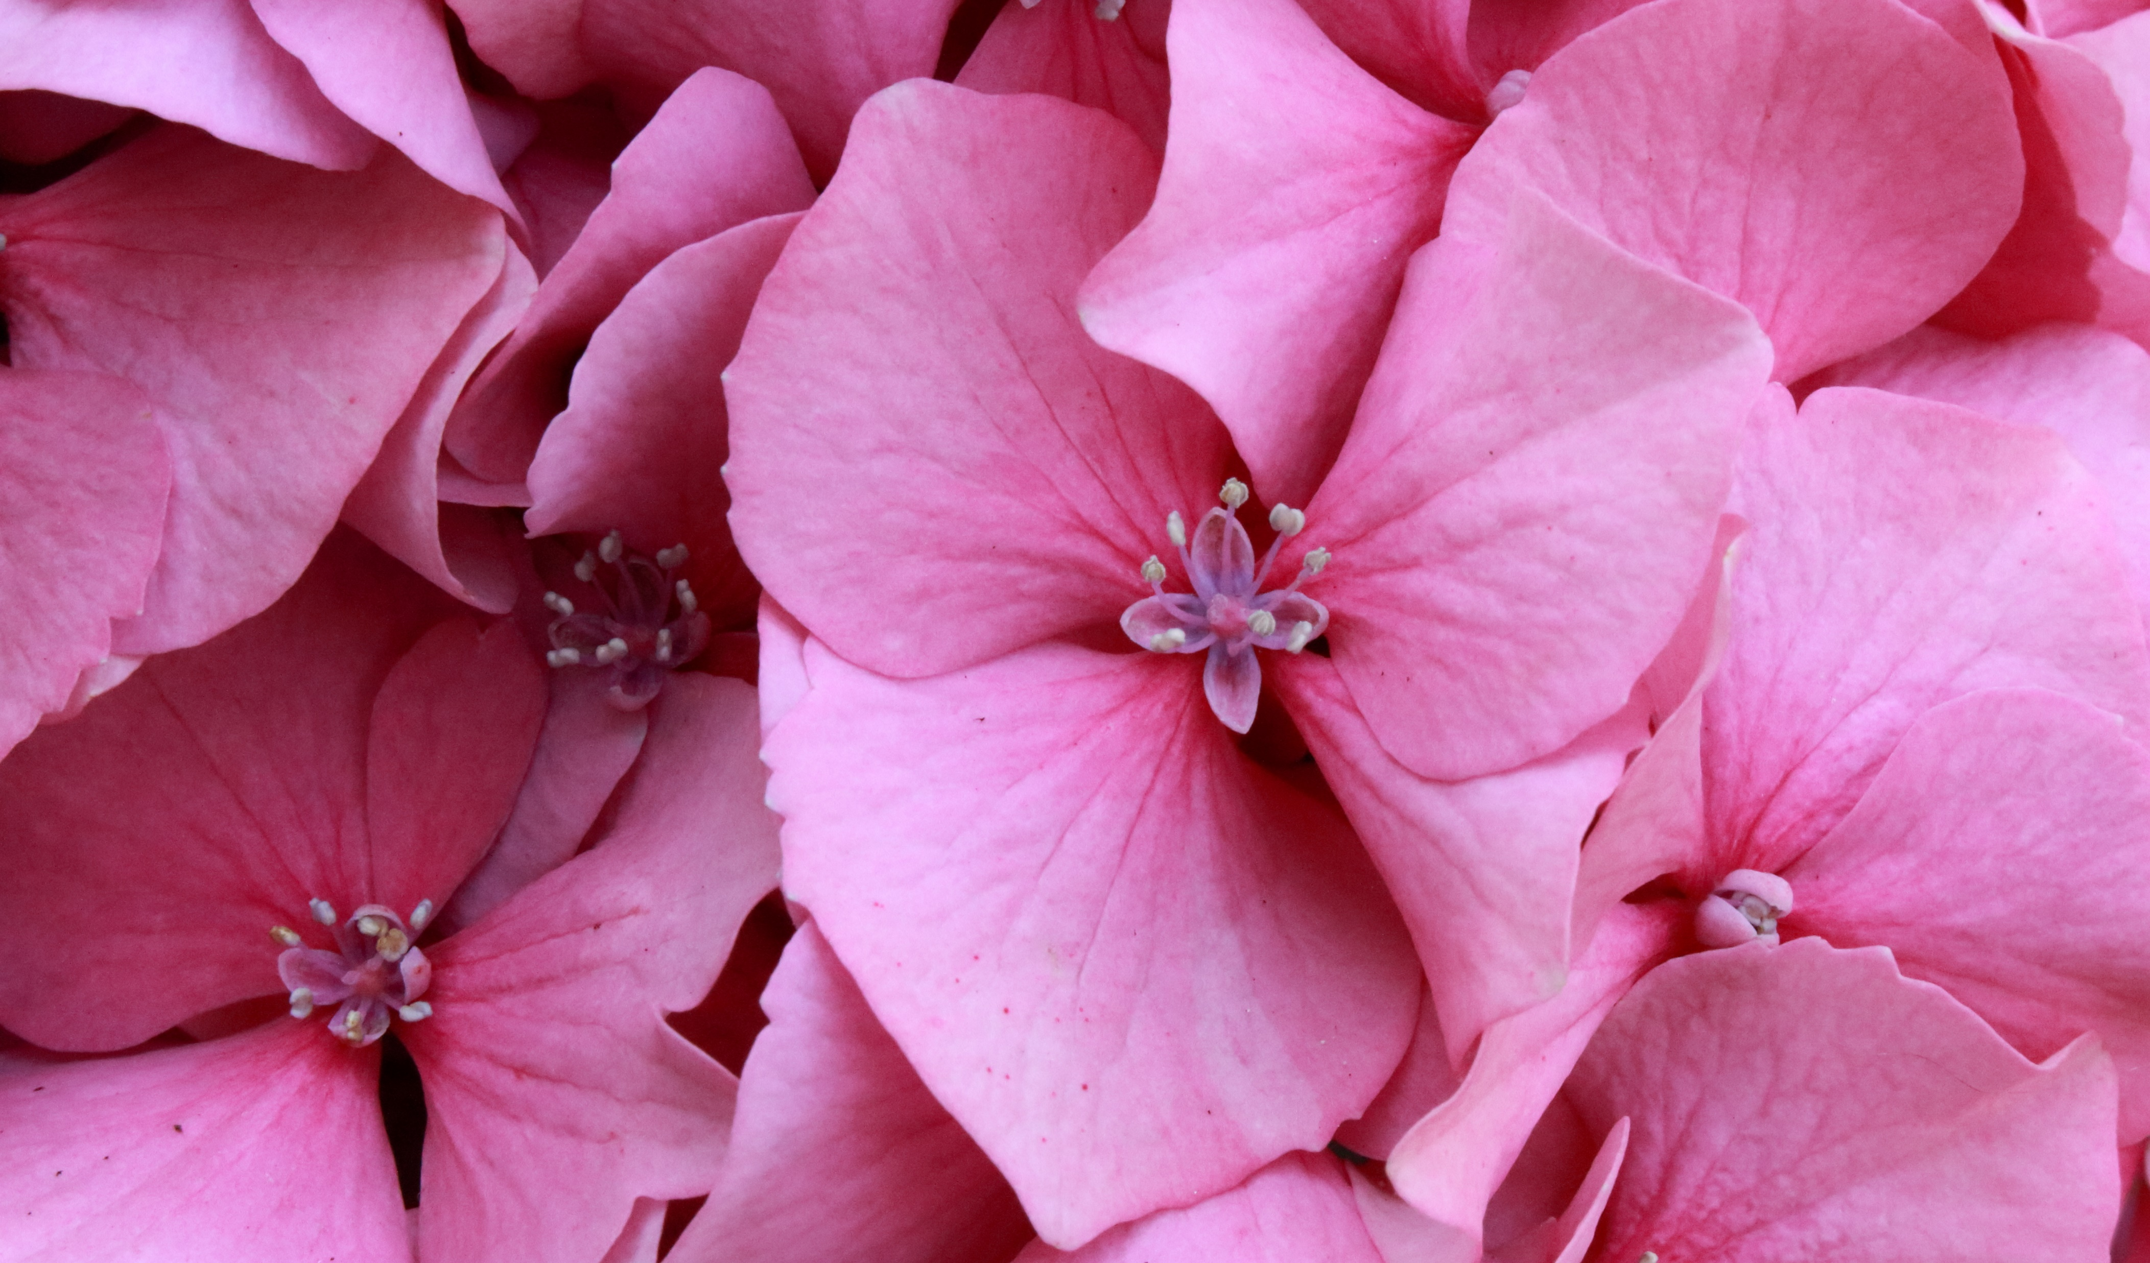
INSPIRATION BOOK
A PIECE OF THE WORLD
THE MOST POPULAR BOOK OF 20XX
ALLAN
MATTSON

Slide 16

INSPIRATION
FROM THE BESTSELLER LIST OF ALL TIME
ALLAN MATTSON
MAKE YOUR DREAM A REALITY

Slide 17

INSPIRATION
MAKE YOUR DREAM A REALITY
ALLAN MATTSON
FROM THE BESTSELLER LIST OF ALL TIME

